Slide 1
Enhanced Large-Scale Modeling of Additive Manufacturing: Layer-wise Equivalent Heat Flux Attribution for Thermal Interaction Analysis across Multiple Fabrications
17th USNCCM
Fan Chen, Dominik Kozjek, Conor Porter, Jian Cao
Email: fanchen@northwestern.edu
Supervisor: Jian Cao
March 24, 2025

Slide 2
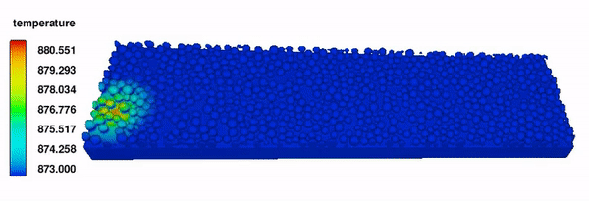
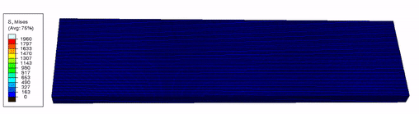
Background
High-fidelity coupled CFD-FEM modeling
Metal additive manufacturing (AM) process:
Laser powder bed fusion
Directed energy deposition
CFD
Temperature history determines:
Residual stress
Fluid dynamics
Microstructure evolution
Part distortion
Defects
Mechanical properties
Coupled CFD-FEM
Two-layer two-track: high computational cost
Chen F, Yan W. Materials & Design, 2020, 196: 109185.

Slide 3
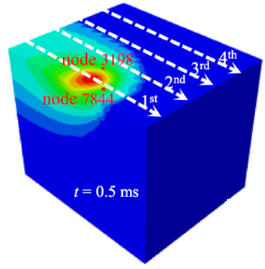
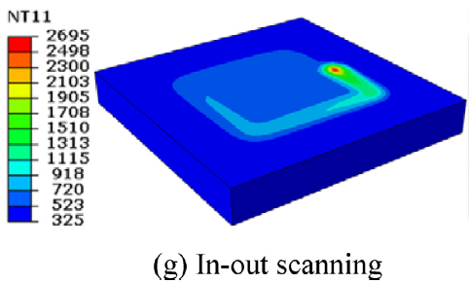
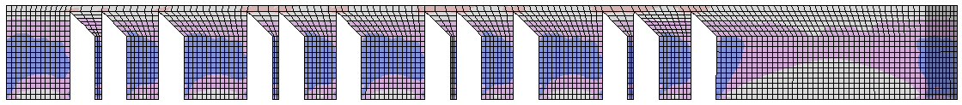
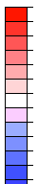
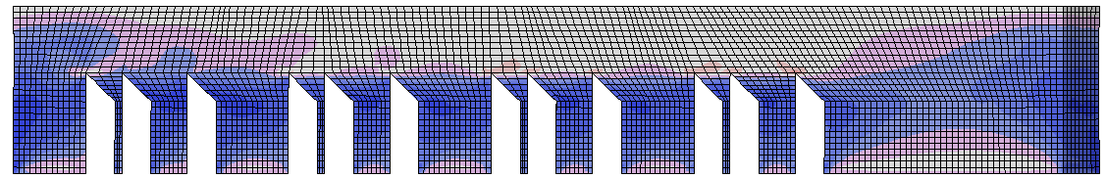
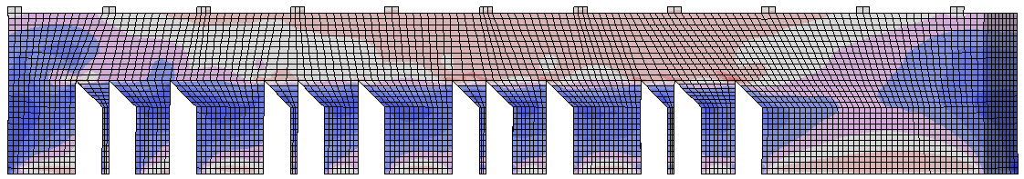
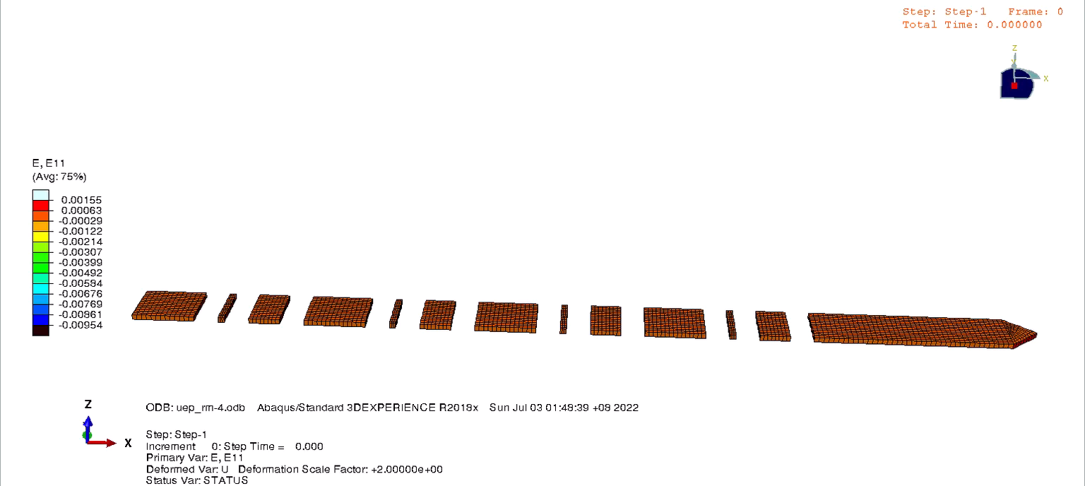
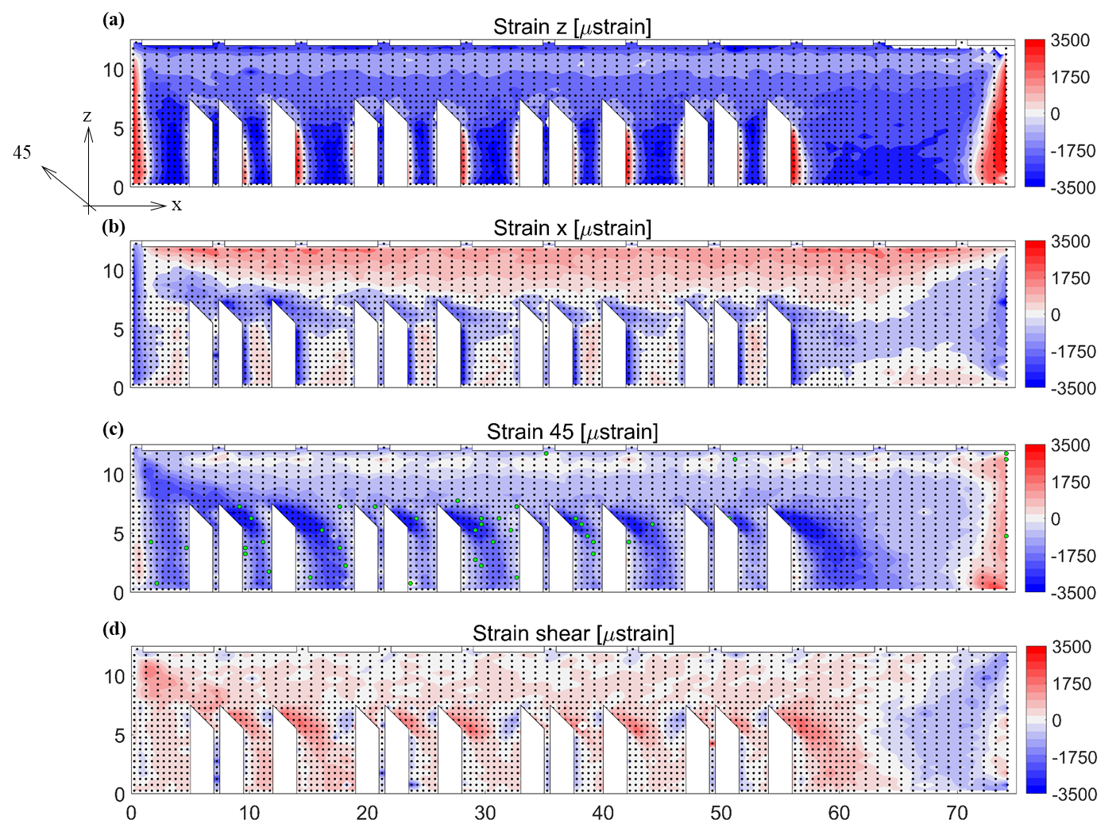
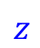
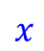
Large-scale FEM approaches in AM (1/2)
Track-by-track heating + agglomeration
Part height:50 mm
Part height:75 mm
X-X strain component
(μstrain)
3500
2920
2330
1750
1170
580
0
-580
-1170
-1750
-2330
-2920
-3500
Part height:115 mm
M Yi et. al. [1]
B Cheng et. al. [2]
Equivalent strain/temperature attribution _{[3,4]} + element activation
Part height:125 mm
$$z$$
Temperature
Strain tensor
Cooling
Relaxation
$$x$$
Equivalent layer
X-X strain component
(μstrain)
Experimental measurement
Accurate inherent strain pattern + Neutralization
[11 Yi M, Xu B X, Gutfleisch O. Computational Mechanics, 2019, 64(4): 917-935.
[2] Cheng B, Shrestha S, Chou K. Additive Manufacturing, 2016, 12: 240-251.
[3] Olleak A, Xi Z. Manufacturing Letters, 2020, 24: 140-144.
[4] Liang, X., Chen, Q., Cheng, L., Hayduke, D., & Albert C. To (2019). Computational Mechanics, 64, 1719-1733.

Slide 4
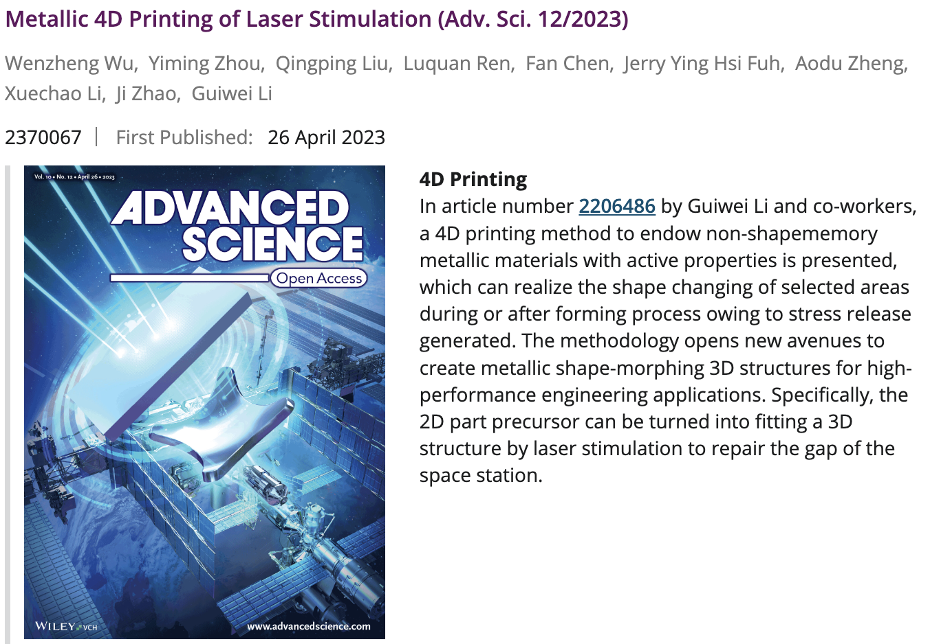
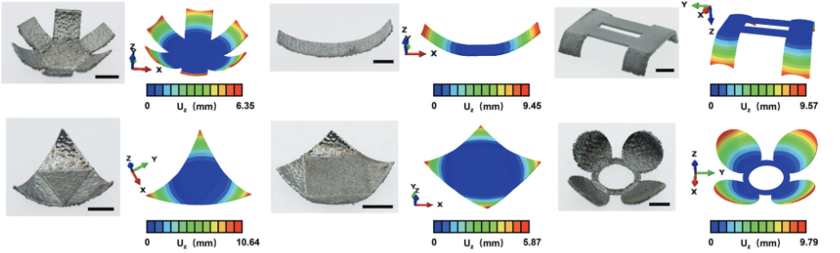
Large-scale FEM approaches in AM (2/2)
(Selected as the cover of “Advanced Science 12/ 2023” Wu, W. et al)
Heating step
Cooling step
Temperature
Heat flux
Radiation
Convection
Layer refresh
Distortion and residual stress can be accurately predicted by:
the reasonable configurations of the equivalent stress, strain, heat flux or temperature attribution.
[1] Wu, W., Zhou, Y., Liu, Q., Ren, L., Fan, C., Fuh, J. Y. H., ... & Li, G. (2023). Advanced Science, 10(12), 2206486.
[2] Alvarez P, Ecenarro J, Setien I, et al. Int. J. Eng. Res. Sci, 2016, 2(10): 39-46.

Slide 5
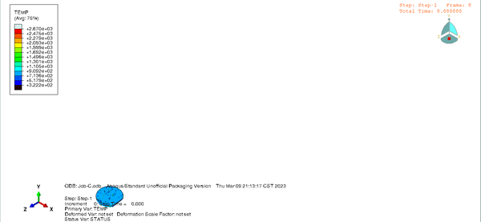
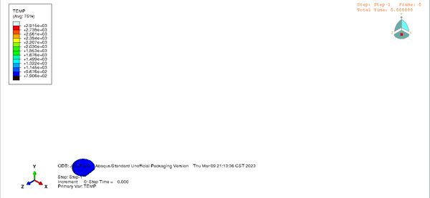
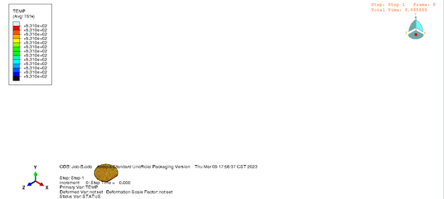
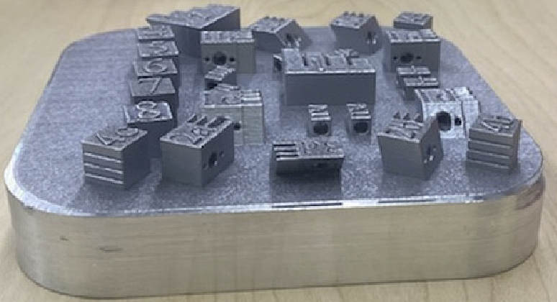
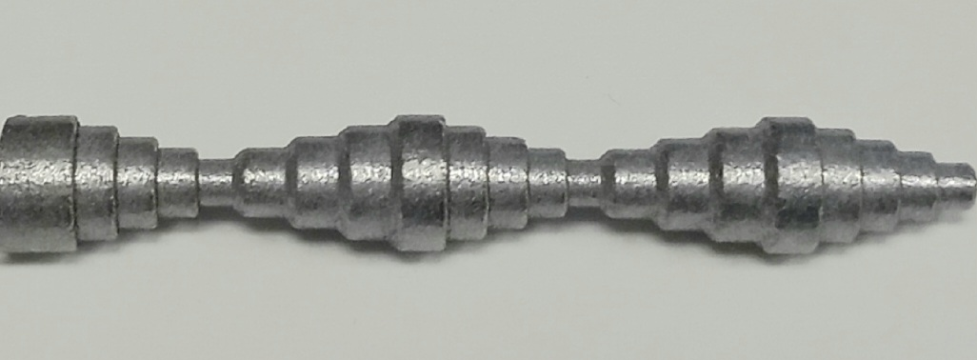
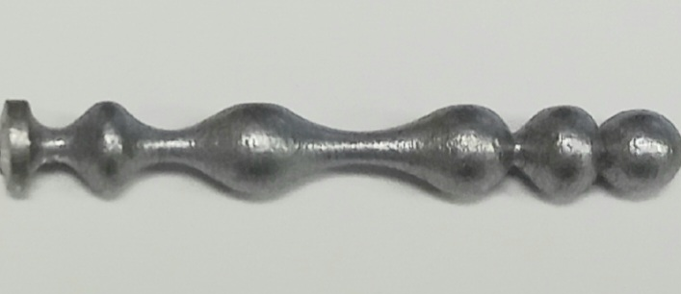
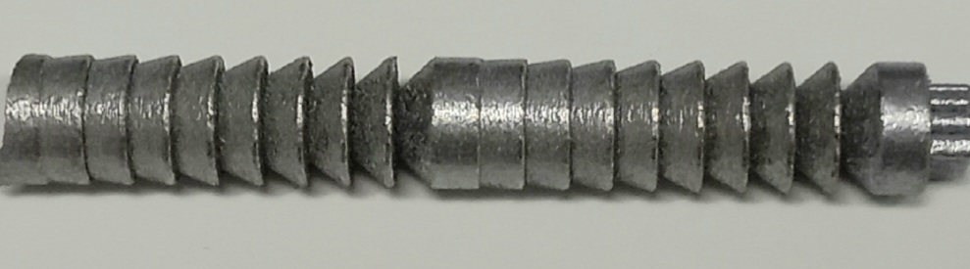
Problems
Individual specimens
Single part simulation
Advantages:
Easy implementation
Good efficiency
Problems
Material deposition
Heat source
Thermal boundary
(Dominik and Conor)
Multiple parts:
Geometry feature
Scan pattern
Interlayer heat variation
Assumptions & Simplifications:
(Kozjek et al.)
Fabrication design
Temperature field prediction
Kozjek, D., Porter, C., Carter III, F. M., Mogonye, J. E., & Cao, J. (2023). Journal of Manufacturing Processes.

Slide 6
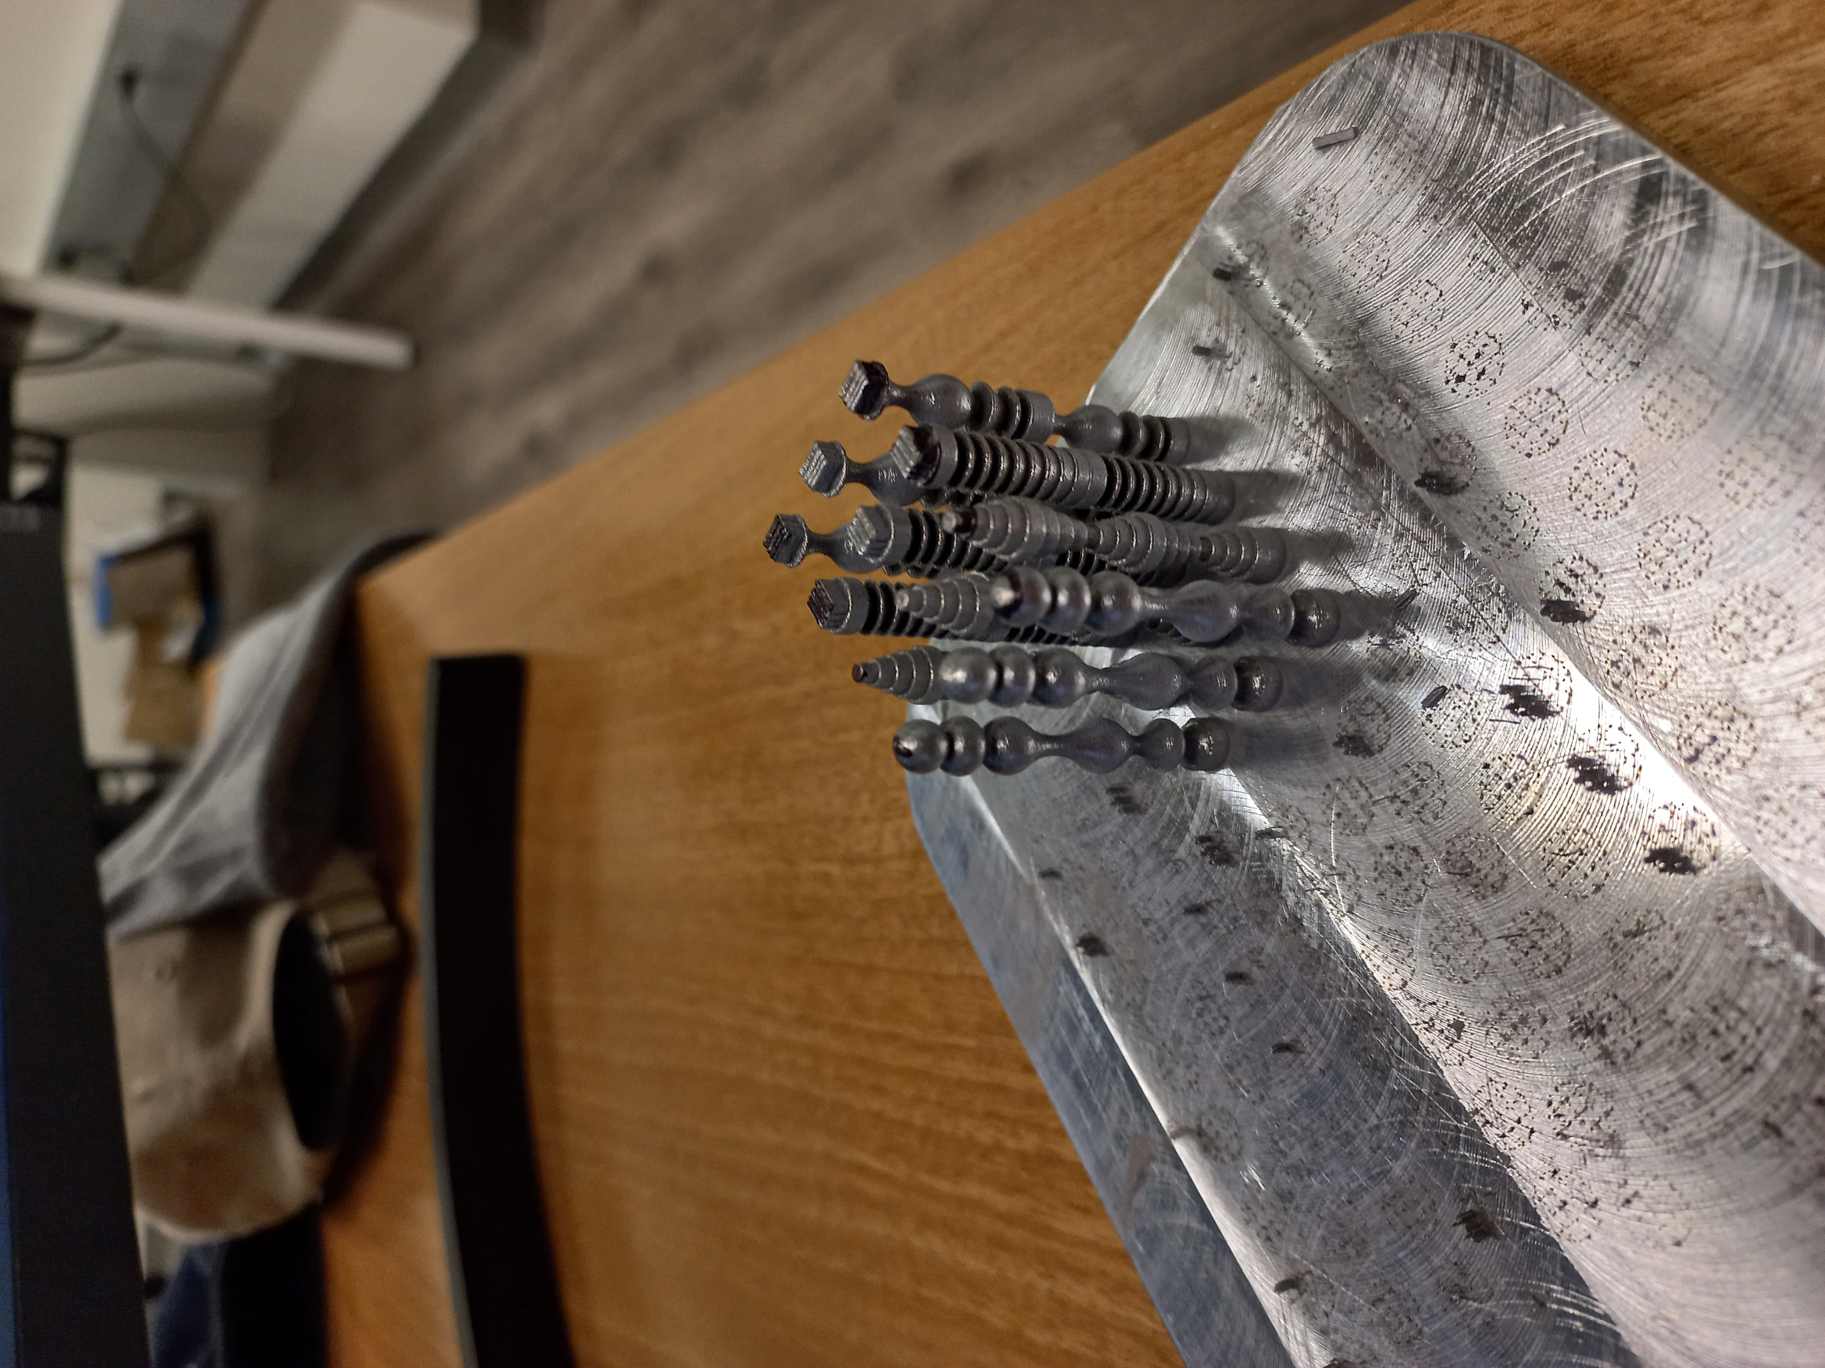
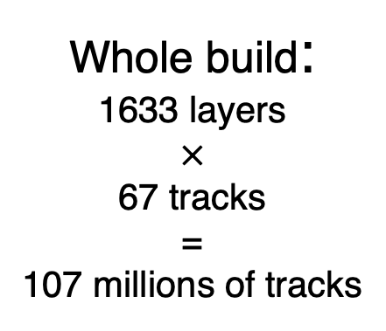
Objective of this research
Specimen cluster
Whole build:
1633 layers
$×$
67 tracks
=
107 millions of tracks
Multiple specimens simulation:
Reasonable thermal boundary;
Incorporation of scan pattern;
Easy implementation;
Good accuracy.
Substrate
(Dominik and Conor)
Kozjek, D., Porter, C., Carter III, F. M., Mogonye, J. E., & Cao, J. (2023). Journal of Manufacturing Processes.

Slide 7
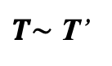
Proposed modeling framework
Track-by-track simulation
Equivalent heat flux determination
Large-scale simulation
Start
Equivalent heat flux Q_{e} (S)
Part geometry and building speed
Layer thickness
Yes
CAD files
No
$T\sim$ T’
Layer-wise element activation and heat flux attribution
Heat source parameters
Calculate temperature pattern T’
Temperature field of whole build
Track-wise deposition
Single layer(S)
Single layer
End
Heat flux attribution
Calculate temperature pattern T
Determine heat flux Q

Slide 8

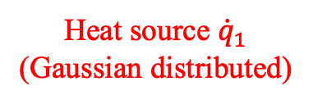
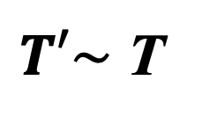
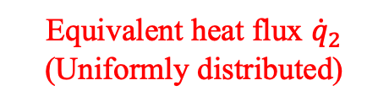
Proposed modeling framework
Model 1: Track-by-track heating
Model 2: layer-wise heat flux attribution
Heat source ${\dot{q}}_{1}$
(Gaussian distributed)
Equivalent heat flux ${\dot{q}}_{2}$
(Uniformly distributed)
Substrate
Substrate
Cooling
Cooling
$T′\sim$ T
Temperature pattern T
Temperature pattern T’

Slide 9
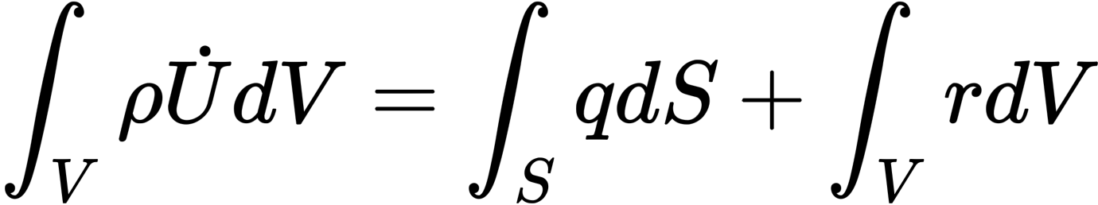
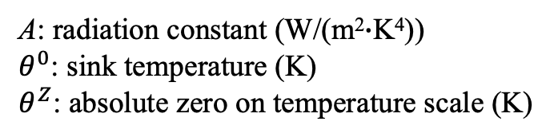
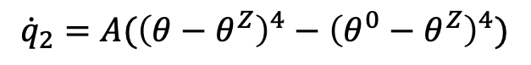
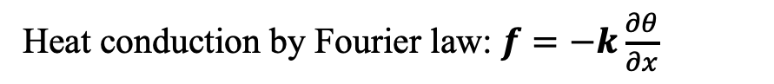
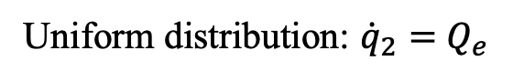
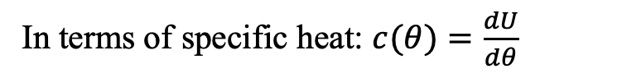
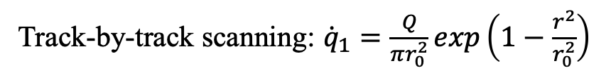
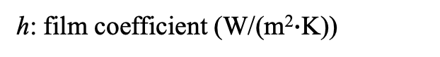
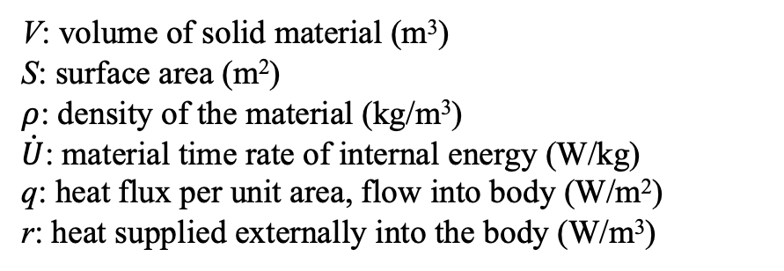
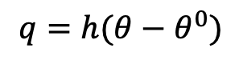
Governing equations
Energy balance
Surface heat flux
Track-by-track scanning: ${\dot{q}}_{1}=\frac{Q}{πr_{0}^{2}}exp\left(1−\frac{r^{2}}{r_{0}^{2}}\right)$
V: volume of solid material (m³)
S: surface area (m²)
$ρ$: density of the material (kg/m³)
$\dot{U}$: material time rate of internal energy (W/kg)
q: heat flux per unit area, flow into body (W/m²)
r: heat supplied externally into the body (W/m³)
Uniform distribution: ${\dot{q}}_{2}=$ $Q_{e}$
Radiation
${\dot{q}}_{2}=$ $A({\left(θ−θ^{Z}\right)}^{4}−{\left(θ^{0}−θ^{Z}\right)}^{4})$
A: radiation constant (W/(m²$∙$K⁴))
$θ^{0}$: sink temperature (K)
$θ^{Z}$: absolute zero on temperature scale (K)
Constitutive definition
In terms of specific heat: $c(θ)=\frac{dU}{dθ}$
Surface convection
$q=$ $h(θ−θ^{0})$
Heat conduction by Fourier law: $f=−k\frac{∂θ}{∂x}$
h: film coefficient (W/(m²$∙$K))

Slide 10
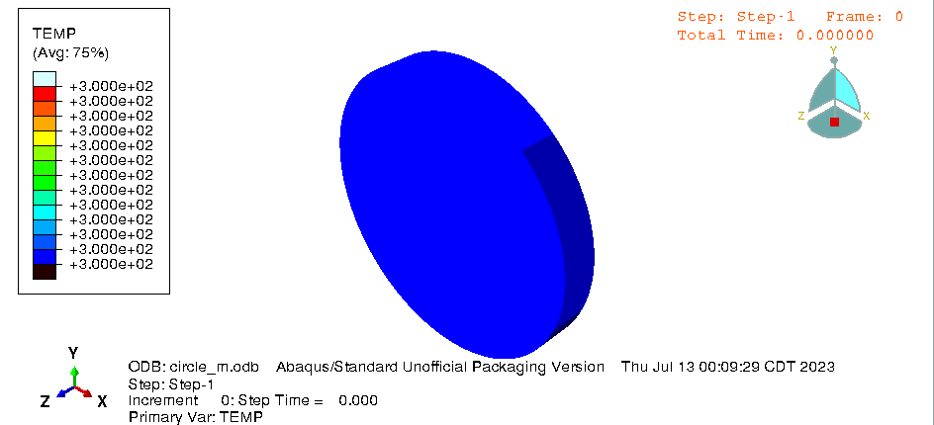

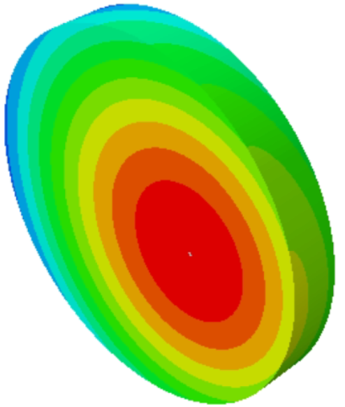
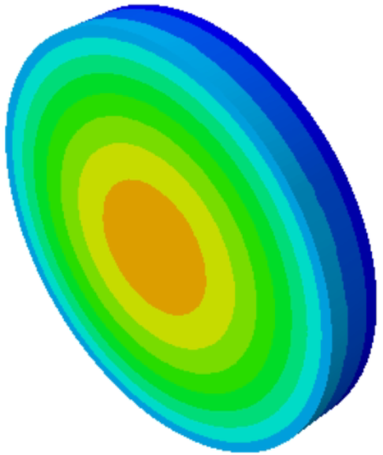
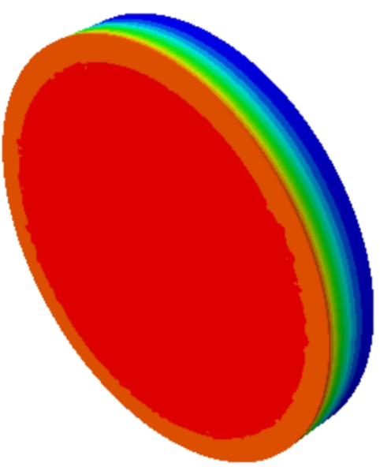
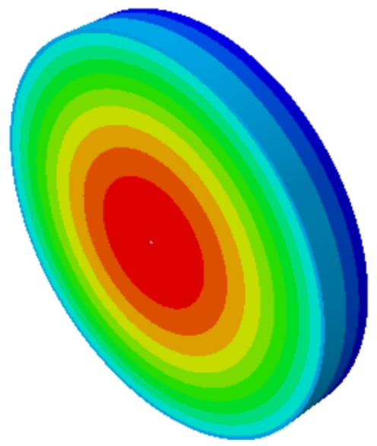
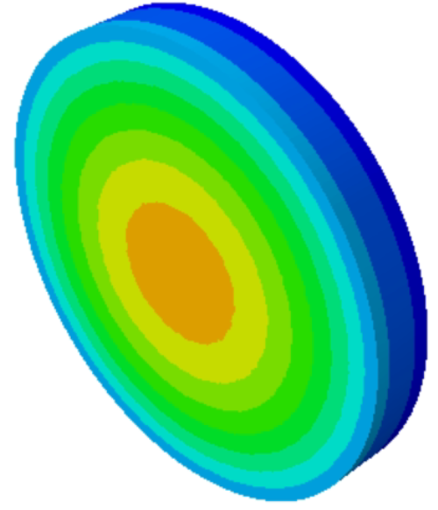
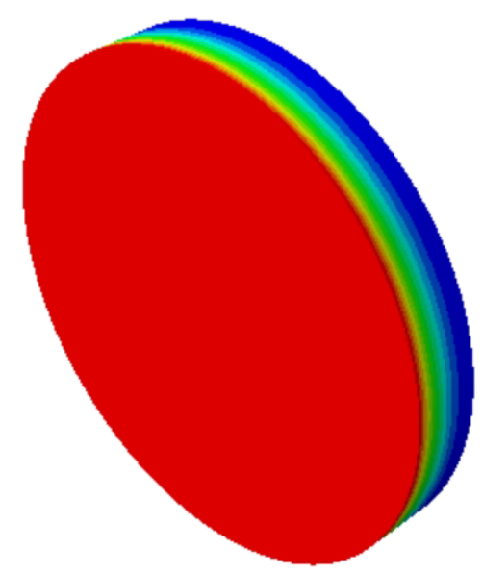
Circular shape
Model 1: Track-by-track heating
t_{c} = 10 s
Temperature (K)
Laser ending point
Scan pattern
t = t₀
t = t₀ + t_{c}
Model 2: Equivalent heat flux attribution
Cooling
Heat flux Q_{e}
t = t₀
t = t₀ + t_{c}

Slide 11
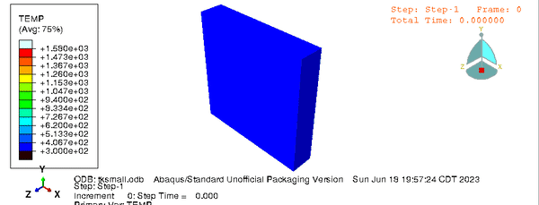
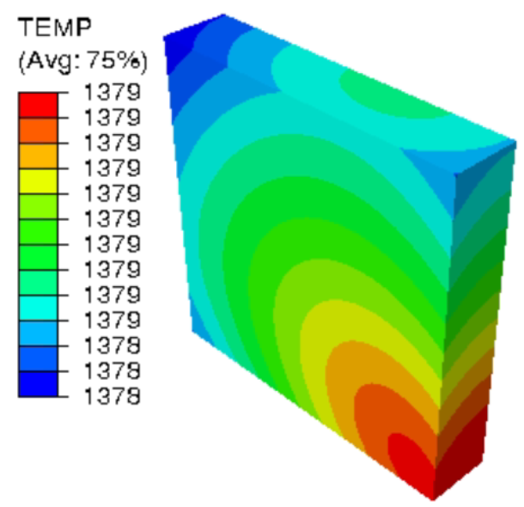
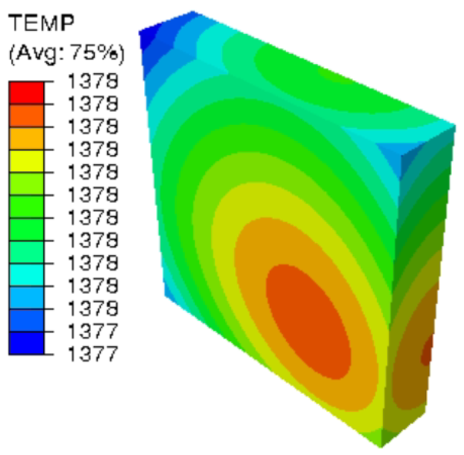
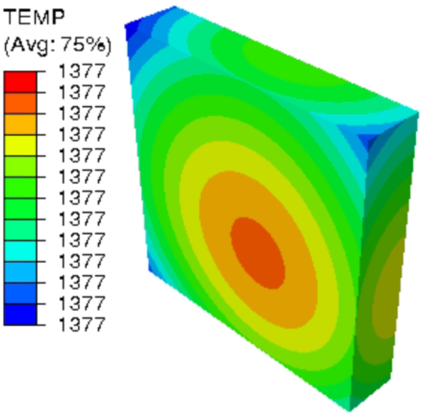
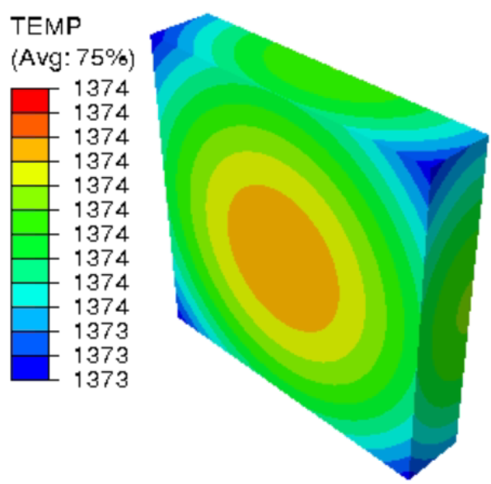
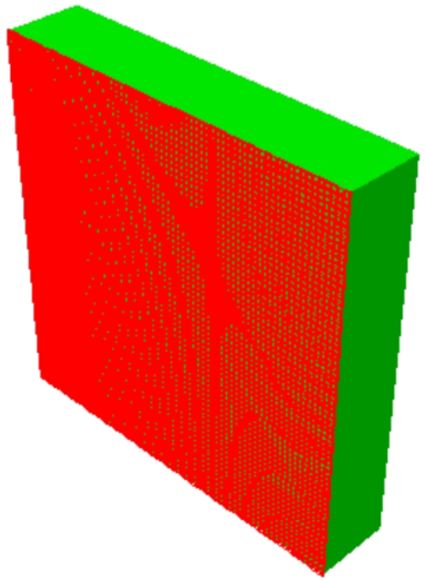




Rectangular shape
Model 1: Track-by-track heating
t_{c} = 10 s
Scan pattern
Temperature (K)
Laser ending point
t = t₀
t = t₀ + t_{c}
Model 2: Equivalent heat flux attribution
Cooling
Heat flux Q_{e}
t = t₀
t = t₀ + t_{c}
If Q_{e} is properly selected:
The two different heating method obtain the similar temperature pattern after the cooling time t_{c}.
(under the same thermal boundary conditions)

Slide 12
Heat transfer analysis on a single layer
Q_{e} at different radius
(preheating 300 K)
Q_{e} at preheating temperature
(circular radius 3.75 mm)
Preheating (K) | Q_{e} (W/m²) | Temperature after cooling (K) | Residual temperature with Q_{e}=29.2 W/m²
300 | 29.2 - 29.3 | 785.6 | 785.6
500 | 28.2 - 28.3 | 802.7 | 803.2
700 | 27.8 - 27.9 | 856.5 | 857.1
Residual temperature: the preheating for the next layer

Slide 13










Heat transfer analysis on a single layer
$$c\left(θ\right)=dU/dθ$$
Area= latent heat
residual temperature
temperature after heating
residual temperature for next deposition
Liquidus
$$θ_{n}$$
$$θ_{l}$$
$$θ_{n+1}$$
Solidus
Heating (Q_{e})
Cooling (Q_{c})
$$θ_{n}$$
$$θ_{n+1}$$
$$θ_{l}$$
$$θ$$
Temperature change: $∆θ=\frac{U}{cm}$
U: energy
c: specific heat
m: mass
Assumption:
To make the similar $∆θ$, Q_{e} is primarily depending on
laser parameters
cross section area S
(Rough estimation)

Slide 14



Part-scale heat flux attribution
Thermal load
Track-by-track heating
Uniform distributed heat flux
Thermal boundary condition
LPBF:
Thermal conduction of the powder particles cannot be simplified as radiation and convection
Building direction
Computational cost (per layer):
2~3 CPU hours
Within 1 min

Slide 15


Model geometry of the specimen clusters
Powder block
c
Group 1
Fatigue samples
Group 2
b
Group 3
a
Group 4
(By Conor Porter)
Target fabrications

Slide 16

Model construction
Part-scale simulation:
Track-scale simulation:
scan speed: 1550 mm/s
laser power: 240 W
absorptivity: 0.45
material: AlSi10Mg
hatch distance: 150 um,
layer thickness (nominal): 30 um
Powder block
Specimen
scan path: bio-directional
Q_{e}(S)
S: cross section area
cross section shape: circular
Substrate
Layer-wise element progressive activation +
Mesh:
Total element numbers: 868’364
Element type: DC3D10
Apply Q_{e} on specimen cross sections
[1] Wei L C, Ehrlich L E, Powell-Palm M J, et al., Additive Manufacturing, 2018, 21: 201-208. _{(0.2-0.3 %)}
[2] Jacob G, Donmez A, Slotwinski J, et al., 2016, 27(11): 115601. _{(84% density)}

Slide 17



Temperature results
Temperature evolution during the fabrication procedure
Specimen cluster
Single part
Whole build
Specimen
Cross comparison
Computational cost: 20 ~30 mins
Computational cost: 5~15 mins
Layer-wise element progressive activation + Layer-wise heat flux attribution

Slide 18




Temperature results
Temperature field during manufacturing
Temperature distribution after heating (example: Group 4)
Powder block
Single part simulation (for comparison)
Specimen cluster
Same geometry & Thermal load
Specimens
Different temperature distribution
a
b
c
Center region:
Small cooling rate
Heat accumulation
High temperature on the specimen in the center region.

Slide 19

Experiment design
Target specimens
Machine: DMG MORI LASERTEC 12 SLM (LT 12 SLM)
Powder: TEKMAT™ AlSi10Mg-63/20-AMS (TEKNA, Montreal, CA)
(by Dominik and Conor)
Lane B, Jacquemetton L, Piltch M, Beckett D. Thermal calibration of commercial melt pool monitoring sensors on a laser powder bed fusion system. NIST Advanced Manufacturing Series 2020;100(35):100-35.

Slide 20


Experiment design
Coaxial photodiode system
Molten pool temperature measurements (TEP)
y [mm]
TEP [°C]
(Lane et al., 2020)
x [mm]
(by Dominik and Conor)
Lane B, Jacquemetton L, Piltch M, Beckett D. Thermal calibration of commercial melt pool monitoring sensors on a laser powder bed fusion system. NIST Advanced Manufacturing Series 2020;100(35):100-35.

Slide 21

Preheating and melt pool temperature relation
(Luo X. et. al.)
Simulation temperature field
Residual temperature after heating
(Preheating of next layer)
VS
Experimental measurement
Average molten pool temperature
When the preheating temperature increases from 25 ℃ to 400 ℃,
the molten pool central temperature increases from 2621 ℃ to 2914 ℃.
Luo X, Zhao M, Li J, et al. Numerical study on thermodynamic behavior during selective laser melting of 24CrNiMo alloy steel[J]. Materials, 2019, 13(1): 45.

Slide 22
Measured molten pool temperature
Experimental measurement (by Dominik and Conor)

Slide 23
Measured molten pool temperature
Experimental measurement (by Dominik and Conor)

Slide 24
Comparison of simulation and experiment results
Multiple parts simulation VS Experiments
Local fluctuation due to:
large element size
large time step
activation of the new elements
thermal interactions
Group 1

Slide 25
Comparison of simulation and experiment results

Slide 26
Comparison of simulation and experiment results

Slide 27
Comparison of simulation and experiment results
The results indicates:
the potential relationship between preheating and molten pool temperature;
the thermal interaction effects by the heat conduction of inter-specimen powders;
Overall, multiple parts simulation and experimental measurement show a similar trend.

Slide 28
Comparison of simulation and experiment results
Single part simulation VS Experiments (by Dominik)
Simulation (normalized):
Experiment (normalized):
Group 4-a
Group 4-b
Group 4-c
z
Heat transfer simulation
For the single part simulation:
no thermal interaction
unreasonable thermal boundary conditions
Experiment specimen

Slide 29
Multiple .vs. single part (Group 4)
Multiple parts
Single parts

Slide 30




Comparison of simulation and experiment results
Normalization
R² (Multiple parts simulation VS Experiments)
 | a | b | c
Group 1 | 0.48 | 0.66 | 0.6
Group 2 | 0.32 | 0.43 | 0.14
Group 3 | 0.35 | -0.76 | -0.09
Group 4 | 0.34 | 0.53 | 0.44
R² (coefficient of determination)
$$R^{2}=1−\frac{RSS}{TSS}$$
RSS= sum of squared residuals
TSS= total sum of squares
$$RSS=\sum_{i}{{(y_{i}−f_{i})}^{2}}$$
R² (Single part simulation VS Experiments)
$$TSS=\sum_{i}{{(y_{i}−\overline{y})}^{2}}$$
 | a | b | c
Group 4 | -1.2 | -2.59 | -3.31
(by Dominik)
$R^{2}<0$: large difference

Slide 31

Feasibility in large-scale thermal modeling
Multiple islands heating test:
Model geometry
Two different heating configurations

Slide 32








Feasibility in large-scale thermal modeling
Model 1: Track-by-track heating
Heating end point
Similar residual temperature pattern
Heating end point
Similar residual temperature pattern
High thermal conductivity,
Rapid scan speed,
Large island area,
Heating by equivalent heat flux attribution always produces a temperature pattern similar to that achieved by track-by-track heating.
Heating procedure
Heating procedure
Short period of cooling
Short period of cooling
Model 2: Equivalent heat flux attribution
Thermal loading direction
1st island
4th island

Slide 33








Feasibility in large-scale thermal modeling
Model 1: Track-by-track heating
Similar residual temperature pattern
Heating end point
Similar residual temperature pattern
High thermal conductivity,
Rapid scan speed,
Large island area,
Heating by equivalent heat flux attribution always produces a temperature pattern similar to that achieved by track-by-track heating.
Heating end point
Heating procedure
Heating procedure
Short period of cooling
Short period of cooling
Model 2: Equivalent heat flux attribution
12th island
7th island

Slide 34



Feasibility in large-scale thermal modeling
Temperature difference
Strategy 1
Strategy 2
Observations:
1. Scan orientation affects residual temperature pattern;
2. Prediction error can be accumulated with cross-section area
3. Prediction error is tolerable compared to the global temperature change.

Slide 35
Highlights & Summary
Development of an integrated part-scale modeling framework that combines layer-wise equivalent heat flux attribution with layer-wise element activation.
Justification of the equivalent heat flux through high-fidelity track-scale simulations.
Incorporation of the inter-specimen heat conduction effects through the powder bed.
Remarkable consistency of the simulated temperature data obtained from each equivalent layer compared to the experimental observations
A rational explanation for the different temperature distributions and cooling rates observed in samples with identical geometries but at different position.
A sound physical basis and excellent computational efficiency.

Slide 36
Future work
Thermal interaction:
Incorporating depositing sequence for cross sections of different samples;
Data-driven approaches:
Predicting Q_{e} and temperature curves using machine learning approaches;
Different part shape:
Analyzing the effects of various cross-section shape.

Slide 37
Acknowledgements
Department of Defense Vannevar Bush Faculty Fellowship
Notes:
Thank you for your attention!
Any questions, comments, or suggestions are welcome.

